Slide 1
Welcome to Presentation
Course : Software Engineering WS 2018/19
Gaussian and Mean Filters for Noise Removal
Submitted By : Harshal Vaze
Matriculation No: 1269879

Slide 2
Contents
What is Gaussian Filter?
What is Mean Filter?
Difference between Gaussian and Mean Filters
How to use these Filters?
Result

Slide 3
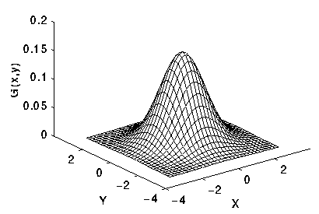

Gaussian Filter
In image processing, a Gaussian blur (also known as Gaussian smoothing) is the result of blurring an image by a Gaussian function. It is a widely used effect in graphics software, typically to reduce image noise and reduce detail. The idea of Gaussian smoothing is to use this 2-D distribution as a ‘point-spread’ function and this is achieved by convolution.
where σ is the standard deviation of the distribution
2-D Gaussian distribution with mean (0,0) and σ = 1

Slide 4
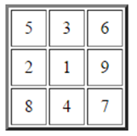
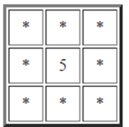
Mean Filter
The mean filter is a simple sliding-window spatial filter that replaces the center value in the window with the average (mean) of all the pixel values in the window. The window or kernel, is usually square but can be any shape.
An example:
Summation = 5 + 3 + 6 + 2 + 1 + 9 + 8 + 4 + 7
= 45
Mean = 45 / 9 = 5
Unfiltered values | Mean Filtered

Slide 5
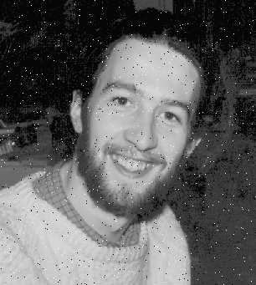
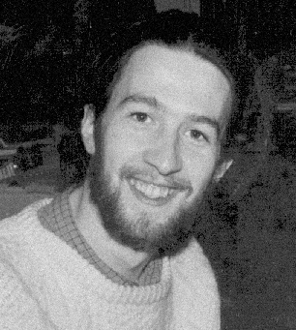
The idea of mean filtering is simply to replace each pixel value in an image with the mean (average) value of its neighbours, including itself. This has the effect of eliminating pixel values which are unrepresentative of their surroundings. Mean filtering is usually thought of as a convolution filter.
Image with Noise | Mean Filtered Image

Slide 6
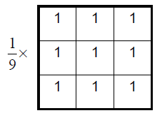
Kernels of Filters
Difference between Gaussian and Mean filter is the Matrix Kernel of both the filters.
Gaussian Kernel | Mean Kernel

Slide 7
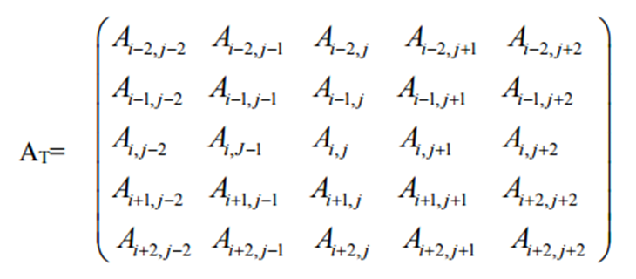
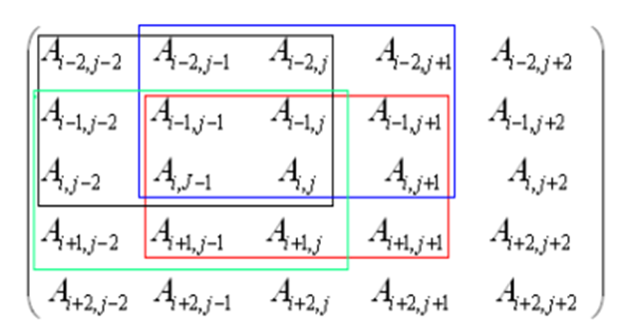
How to use these Filters?
Consider a 5 x 5 test window A_{T} from the noisy image as:
Divide this window into 3 x 3 sub-windows such that the test pixel should appear in each of the sub-windows. Nine such sub-windows are possible and four of them are as shown alongside.

Slide 8
3. For each 3x3 sub-window, calculate the standard deviation (σ_{i}), i=1, 2 …. N
where N is maximum number of the sub-windows.
4. Set reference standard deviation (σ_{ref}), as median of σ_{i}.
5. Set σ_{min} = k1 x σ_{ref}.
6. Set σ_{max} = k2 x σ_{ref}.
7. Calculate average (σ_{avg}) of the standard deviations σ_{i,} whose standard
deviation lies in the range [σ_{min}, σ_{max}].
8. This σ_{avg} is used as a parameter to decide whether the test pixel is corrupted
or not.
The above process is repeated by sliding 5x5 window one step forward row
wise and then column wise to cover the entire image.

Slide 9
Result
Gaussian and Mean Algorithms are implemented in C# using .NET core in accordance with the architecture of LearningApi.
Two Projects were created, one for writing the Algorithm (Class Library Project) and another one for testing (Unit Test Project). Coding methodology is test driven as per LearningApi.
Load Input Image from TestInputImages folder
Convert Bitmap Image into double Array data
Execution of Algorithms from Class Library Project using LearningApi
Convert again double Array data into Bitmap Image
Save the image in TestOutputImages folder
Program Flow

Slide 10




Result
Original Image | Gaussian Filtered Image
Mean Filtered Image | Combined Gaussian And Mean Filtered Image

Slide 11
Thank you

